Slide 1

HOW TO START A NEW XR GROUP
We are facing an unprecedented global emergency. The government has failed to protect us. To survive, it’s going to take everything we’ve got.
This is a roadmap of getting started in your area to grow into a mass movement of 3.5%. It's only a guide, but we hope it's useful! Feel free to adapt this to your local context and needs!

Slide 2
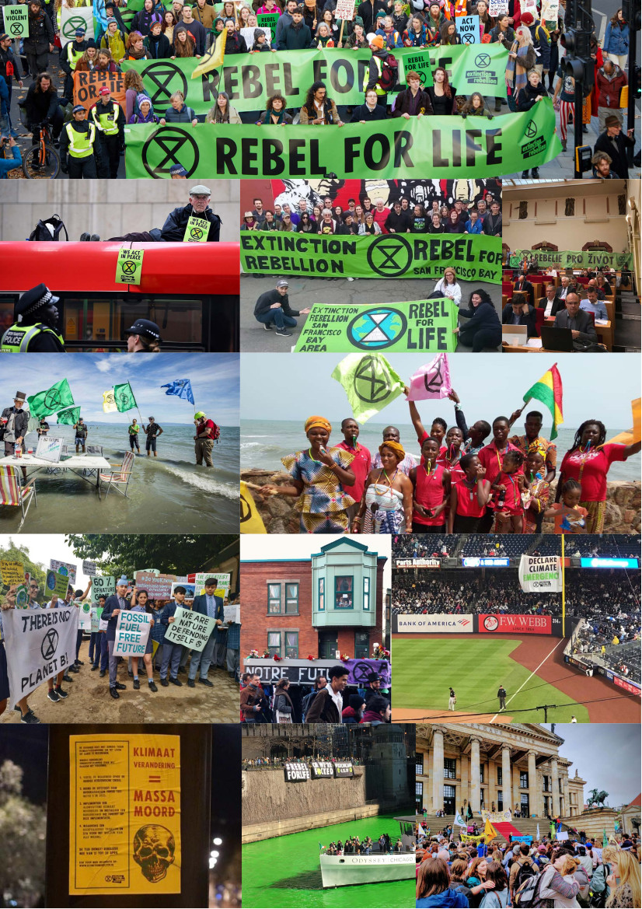
What are we trying to do?
1. To show to radical people that it is possible to have an “impossible” plan and carry out a rebellion – however small (or large!) and increase the “overton window” of acceptable discourse on the ecological crisis.
2. To create an international conversation about the ecological crisis and climate breakdown – including that our families/communities/society and state are facing existential threat. This includes to discuss our demands with the government/ political parties. Also to support further uprisings to demand change off the back of the door we open.
3. To build structure, community and test prototypes in preparation for the coming structural collapse of the regimes of “democracies” - now seen as inevitable due to stored up crisis. Thus preparing a foundation to transform society and resist fascism / other extremes. This includes creating Rising from the Wreckage - a Citizens Assembly based on sortition.
We’re not a political group, we’re a decentralised, global movement. Hopefully this document will help out the many different international groups wanting to establish themselves!

Slide 3
WHAT IS THE INTERNATIONAL SUPPORT TEAM?
The International Support Team (IST), is an international support body for XR national groups. We facilitate the flow of resources and material between groups and offer support in the form of trainings, funding and general communication. It’s made up of rebels from across the world.
Here’s a Visual Representation of the IST, demonstrating the different working groups and their mandates. You can also find the Mattermost usernames of the different working group coordinators here.
The main email for IST is contact@rebellion.global.
There is a network of regional liaisons that act as a point of communication between a group of national/regional groups and IST. Each country will have a regional liaison to offer advice and support. If you don’t know who your regional liaison is, then email the regional liaison coordinators at XR-RegionalLiaisons@protonmail.com.

Slide 4

GETTING STARTED

Slide 5

No Extinction Rebellion (XR) group in your area?
Time to get one started!
Anyone can take action in the name of Extinction Rebellion as long as they adhere to our Principles and Values (see slide at the end). This is a suggested guide to show how you can do that.
Principle 10: WE ARE BASED ON AUTONOMY AND DECENTRALISATION
We collectively create the structures we need to challenge power. Anyone who follows these core Principles and Values can take action in the name of Extinction Rebellion.

Slide 6
GLOSSARY
A Local Group (LG) is a group of people that gather to create an Extinction Rebellion community presence in a local area by building support and taking action towards XR’s three demands. In this way, they are similar to traditional forms of community organising. A crucial difference is that XR local groups decentralise into different Working Groups as much as possible.
A Working Group (WG) focuses on a specific area of work and is allowed to decide how that work gets done. For example, if the Regenerative Culture team want to start outreaching to the Muslim community, they can decide it in their group without asking permission from the rest of the local group (more on decision making later).
A Coordination Group (CG) is a group of the coordinators from the different WGs which meet to decide key local issues and how the working groups will be strategically focused.
Affinity Groups (AGs) are direct action support groups. They are made up of 8-12 people and are autonomous to do the actions they want to in the name of XR as long as they adhere to the Principles and Values.
We like groups!

Slide 7
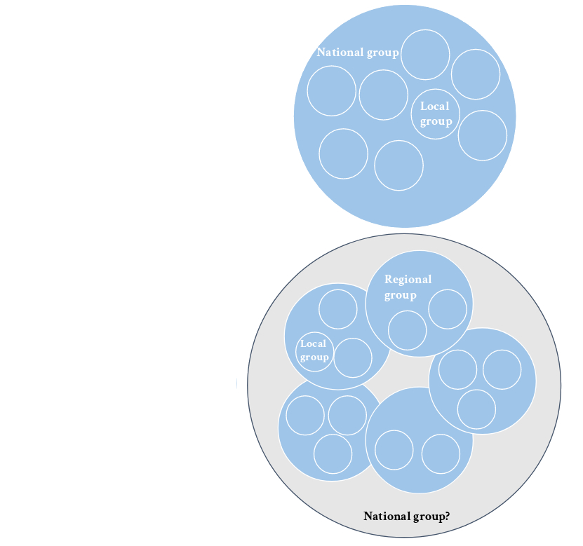
LOCAL, REGIONAL OR NATIONAL GROUP?
Some countries have national and local groups, other countries are made up of multiple regional groups. Some countries have a national team, and regional groups, and many local groups at a town or city level.
If you want to set up a group, but you’re not sure if one exists yet, check out the map and list of groups, or search on social media. Email contact@rebellion.global if you think a group exists but it’s not yet on the map.
If you’re setting up a national team, message the regional liaison for your country for an intro talk! If you don’t know who they are, then ask the regional liaison coordinators. Their contact is XR-RegionalLiaisons@protonmail.com. They will invite you to an intro chat and answer any questions you have.

Slide 8

So you’re feeling rebellious - here’s a few things you might want to do before you get started:
Read Rebel Starter Pack
Connect with nearby local groups
Create social media accounts
(Facebook Pages and Group, Instagram, Twitter)
Create an email - e.g xr-international@protonmail.com

Slide 9
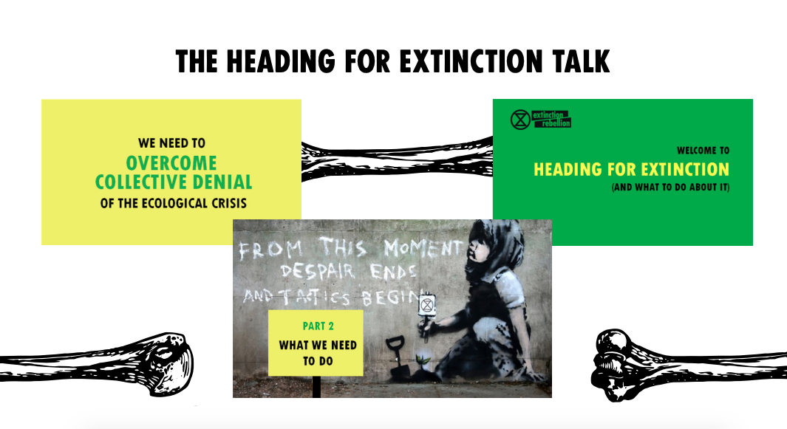

Slide 10

ORGANISE A TALK
1. First you’ll want to gather those that are sympathetic or interested in the Rebellion in your area. Start by organising an XR - ““Heading for Extinction and What To Do About It” talk in your area. You can see if any trainings are available online or you can show this video version in a local cafe/pub/community centre.
2. Creating a event you can share on social media, share it in other local groups and message those that say they are interested. Put a few flyers in local cafes and on community boards.
3. After the talk, ask everyone to sign up on a form (example here) and have snacks/tea around for people to stay afterwards and chat.
More Info here.

Slide 11
HEADING FOR EXTINCTION TALK
This event is ideal to:
Inform your local group members about the rationale behind XR
Reach out to like-minded people in your community
Experiment with different formats (e.g. organise home talks, deliver talk in occupied building)
No of attendants: unlimited
Duration: 2 hours
Check online or ask other local groups if any trainings are available for how to offer the talk!

Slide 12
NONVIOLENT DIRECT ACTION TRAINING
XR is committed to non-violence. It's good to organise an NVDA training after talk so you can invite the talk audience to it. For example, one week afterwards. An NVDA training should:
Train you up in theories and concepts of civil disobedience.
Practice different techniques for Direct Action
Provide you with a short legal briefing
Help you to form Affinity Groups
No of attendants: unlimited
Duration: 3-5 hours
NB: All rebels are recommended to attend NVDA trainings before they participate in our actions!

Slide 13
FORMING A GROUP

Slide 14
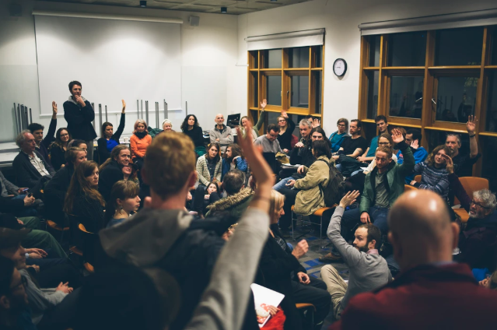
WELCOME MEETING
A welcoming meeting will help to bring new people who are curious about XR together to discuss what it is all about!
You can run a couple of simple workshops to discuss the 10 principles and values and our demands.
Make the meeting fun and relaxed and don’t forget the food!
RESOURCE: Welcome Meeting Workshop Plan

Slide 15

GENERAL MEETING
At your first general meeting, you can start to share the culture of Extinction Rebellion. Some groups start with regenerative exercise, like actively listening to each other for 3 mins or having a “check-in” (to see how everyone is feeling in small groups) for 10 mins.
In the main part of the meeting you can split into Working Groups and the coordinators of each group will join with other rebels to work out plans (e.g design an action, plan outreach into different communities).
At the end everyone comes back together, with someone from each group sharing what you talked about for the whole group, and then finish with a song!
RESOURCE:
An example weekly agenda

Slide 16
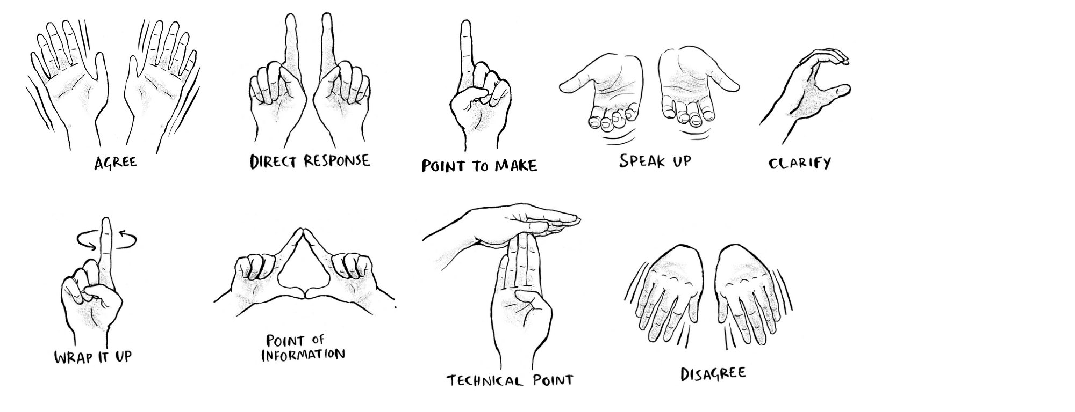
HAND SIGNALS
Hand signals are a useful way to guide a meeting. They may differ in different countries. Here are some examples:

Slide 17

OUR CULTURE
In all of our meetings it is important to highlight how we work together in a respectful culture. This might mean:
Creating a Group Agreement
Using hand signals
Having facilitators to make sure everyone’s voice is heard (you can learn more by watching this video and reading this guide)
Think about how you want to want to work together - here are some tips for inspiration!

Slide 18

AND THAT MEANS HAVING FUN TOO!
You might want to end off meetings with a song or a dance break!
Ideas include:
Film Nights
Gardening
Walks
Gigs
“If I can’t dance to it, it’s not my revolution”
- Emma Goldman

Slide 19
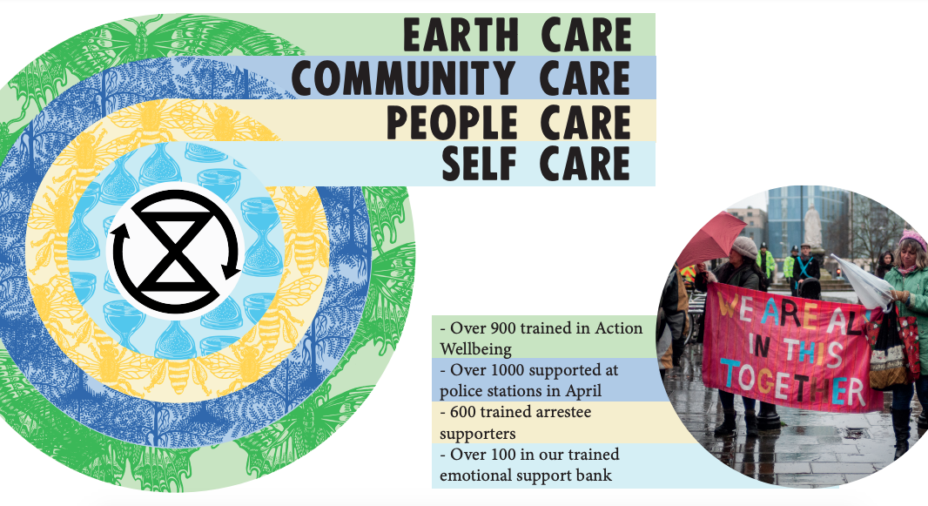
But most importantly, we need to look after ourselves and each other.
Principle 3: We need a regenerative culture - which means creating a culture which is healthy, resilient and adaptable.
Take breaks, enjoy yourself, and listen to your body when it says you need to stop.

Slide 20
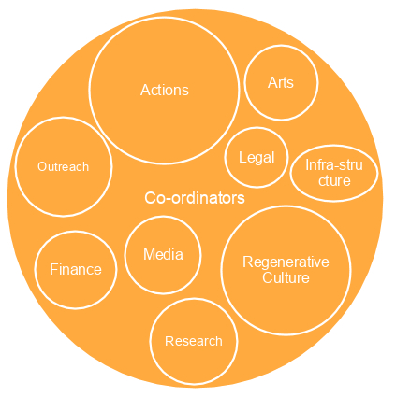
WORKING GROUPS
We organise in small groups. These groups are connected in a complex web that is constantly evolving as we grow and learn.
We are working to build a movement that is participatory, decentralised, and inclusive.
Here is an example of a working group structure that some countries are using. It’s not an exhaustive list. Some groups here may be national, some may be local. As new people join, you’ll want to expand your roles into working groups with their own roles.
The coordinator of each of these groups might form a Coordination Team. Two other useful roles are: internal coordinator and external coordinator
This Ways of Working document might also help rebels when they’re starting up.

Slide 21

AFFINITY GROUPS
As well as Working Groups - which are focused on organising - you might want to have Affinity Groups which are focused on action!
After your NVDA training, small affinity groups, or direct action support groups, are formed. You can also run a separate workshop just to form affinity groups in your area.
Affinity groups can help offer emotional support to other rebels in their group and can take action together locally, like going out to paint the streets (stickering/flyposting), doing a roadblock or blockading a building.
These actions and support will help build confidence for major rebellions.

Slide 22

AFFINITY GROUP RESOURCES
These are all recommendations, don’t forget that Affinity Groups are autonomous to take whatever action they like as long as meets the Principles and Values. It’s powerful to coordinate but don’t ask for permission!
REMEMBER: INDIVIDUALS CAN TAKE PART IN ALL TYPES OF GROUP
You can take part in direct actions with your close-knit Affinity Group, help with specific tasks within your chosen Working Group(s) and also stay connected within the wider community provided by your Local Group.
Resources:
How local groups and affinity groups might work
Affinity group pack
Suggestions for first affinity group meeting

Slide 23

BRINGING IN NEW ORGANISERS (ONBOARDING)
NEWS FLASH:
You can’t build a mass movement on your own! It’s time to help grow your teams and bring new people on board.
From your talks, trainings and other events you should have collected some sign ups by now. You can then check through the people that said they were interested in organising and invite them to get involved.
TIPS:
Have clear roles in mind when you contacting people.
Contacting 1 to 1, either in person (e.g before meetings) or on the phone
Don’t be afraid to ask “What’s your story?” and get chance to really connect.
Make sure they are connected to all your organising platforms so they can connect with others

Slide 24

NEWSLETTER
Keep everyone up to speed with an exciting newsletter.
Post about the work that going on, how much the group is growing, upcoming actions and events to keep everyone in the loop.
Don’t forget we are in open rebellion! Add in some powerful words and quotes to highlight how important the rebellion and everyone involved with it is!

Slide 25

COMMUNICATIONS

Slide 26
WHAT TECH DO REBELS USE?
There are three main platforms:
Mattermost - for quick, and brief communication
Discourse, - more suited for longer, in-depth discussions
Rebel Nextcloud - where rebels can upload and access different XR documents!
Mattermost, Discourse and Nextcloud are set up on the XR global servers. When a new group is established, new rebels are invited to Mattermost, where they can meet other rebels, join different working group channels. To join Discourse, or 'The Base', please send an email requesting invitation to support@organise.earth with the subject: Invitation Request for The Base.
There is also a separate rebel log-in for Nextcloud. This can be found on the Header of the Town Square Mattermost channel.
Check out this Welcome Doc or online video for a more detailed explanation of how to use the platforms.
Here's an invite link to the Global Base on Mattermost. Only share it with people who are committing to being rebels or those who have done an induction training.

Slide 27

Some rebels might have trouble accessing the internet and find it difficult to connect to Mattermost or Discourse. If that’s the case, then we will try our best to ensure you get all the documents that are available through packs like this one. Many working group coordinators still use Signal or Whatsapp to chat together.
Signal is a secure messaging application available for smartphones (it can also be used on laptops). An alternative is Wire. Use Signal/Wire for quick communication within the coordination team and within the working groups via group chats.
If you are having difficulty accessing Mattermost, ask your regional liaison if there are other communication channels that are available for you. For online calls, we tend to use Jitsi or Zoom.

Slide 28
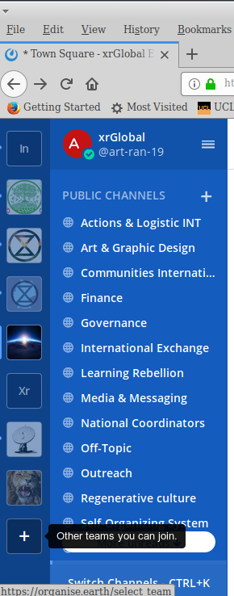
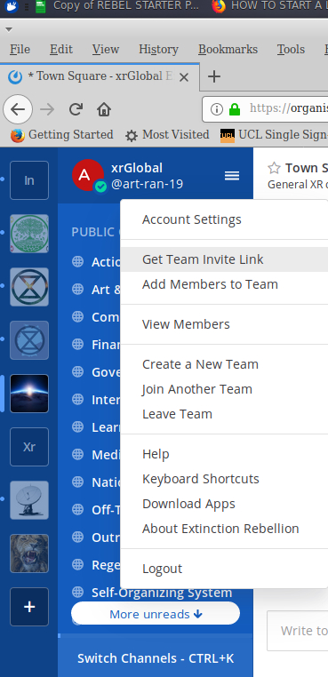
If it’s a completely new group then it will be useful to create a new ‘Team’ on Mattermost. If you know a group already exists on Mattermost and you’d like to join it, then you can message the group coordinators for an invite link to the Team.
To invite people to your new team, click on the ‘+’ on the bottom left. Once you’ve created your Team, click on the Team name, and then ‘Get Team invite Link’.
Now you can send invite links out to your fellow rebels.
There are different channels on Mattermost and Discourse where coordinators from across the world can communicate with each other. If you have varied access to internet connection, many of these groups also use Signal or Wire. The regional liaisons, or fellow rebels can support you if you can’t find what you’re looking for. The global XR network is enormous!

Slide 29
GROWING YOUR GROUP I

Slide 30
AFFINITY GROUP COUNCIL
When there are six or more AGs, you might want to create an Affinity Group Council where spokespeople from each AG can give debriefs on past actions and take future action plans to their affinity groups.
The Affinity Group Council should also include a coordinator from the Actions WG so that they can suggest action plans based on local/national coordination. This method of organising affinity groups is sometimes referred to a spokescouncil.
Though in Extinction Rebellion it is important to recognise that we organise through a post-consensus format which allows autonomous action and doesn’t require all groups to agree on proposed forms of actions.
Want to do it a different way? Feed it back to the AG council. No effect? Go off and do it yourselves !

Slide 31
AFFINITY GROUP SUPPORT NETWORK
Once you've started to set up a few Affinity Groups in your area, you might want to create an affinity group support network. Often newly formed Affinity Groups might be unsure about how to proceed as an autonomous group. The 'AGSN' can help to:
Keep track of all AGs in the area
Stay connected with their coordinators and see how rebellion ready they are
Provide resources
Help organise and run AG Councils
Let AGs know about upcoming actions/ways of getting involved.

Slide 32
GROWING YOUR GROUP
Same faces at the general meeting each week? People taking on more than they can?
It’s time to grow! We need to always be thinking about how we can go to mobilise 3.5% of the population and aiming for that in your local area.
Ways of Growing:
Taking action
Community Organising
Talks in new communities
Starting new groups (e.g. a student group)

Slide 33
ACTIONS
Most groups will grow a lot after periods of rebellion - after the April Rebellion in the UK we saw most groups double in size, or even triple in some places! It’s good to have a plan for this (more later).
Actions in local area will also help you grow and its important to think about how civil disobedience works in XR and what your local context is like when thinking about what kind of action to take.
RESOURCES:
Links to different actions resources coming very soon!

Slide 34

FUNDRAISING - MONEY MONEY MONEY
Rebellion don’t need cash, they need passionate rebels. That said, money helps!
As you grow, there will be more things that need financing, from room hire and food, to potential office spaces or supporting people financially to work more on the rebellion who might not otherwise be able to.
Here are some ideas to get you going:
Do a call out on social media for musicians to help play an XR Fundraiser
Sell some clothing / books at your meeting (not with XR logo on!)
Ask for suggested donations at meetings (food helps!)
Ask local philanthropists/charities for money

Slide 35
PAINT THE STREETS!
One night in 1999, OTPOR (Serbian resistance) activists and artists went out into the night with spray cans and stencils. They were out for 8 hours painting their logo all over Belgrade.
When the city woke up, they thought the revolution was already happening because they could see it around them in public spaces.
You can organise this in your local area, get a bunch of XR posters and some paste, stickers and spray cans and a coordinator that will regularly turn up to hand these out to small groups at a regular time. Then let everyone loose to paint the streets! This can be an easier introduction to civil disobedience to many people.

Slide 36

REBEL PRINTING
Maker-Activists using Printmaking Painting and Sewing to hand make Rebellious Objects for the promotion of XR on a huge scale!
Running block printing workshops onto people's existing clothing, creating spaces for creation and discussion and and turning everybody into a REBEL is great fun and shares how to get creatively involved with the rebellion.
Printers can support actions by providing an endless flow of beautiful objects. You can also cover your local neighbourhood in posters!
Printers can produce:
Patches by the thousands
Flags
Banners
Clothes
RESOURCES:
Folder of “How tos”
Rebel Art Pack
Tips on postering
XR Art Blockers Facebook

Slide 37

COMMUNITY ORGANISING
Momentum driven organising is key in XR - it means not only growing in period of big action but also steadily building through community organising systems.
In 2016, we learnt from the Sanders nomination in the US that a campaign can mobilise 100,000s of volunteers if you create a system for them to get involved with and let them take ownership and organise it. Decentralisation!
RESOURCES:
Ted Talk on Big Organising
Rules for Revolutionaries (Book)
by Becky Bond and Zack Exley
Some tips on setting up a local stall
43

Slide 38

DOOR-KNOCKING/FLYERING
There’s an emergency going on! This truth should be blaring out of our media everyday but it isn’t. We need to go and hear what people think about what’s happening and encourage them to Act Now!
Door-knocking and flyering in XR is encouraging people to express how they feel about the emergency/ their truths. A simple task is if people would like to sign up to receive a local newsletter on what XR is doing and to let them know about regular meeting times.
Setting up a flyering/door-knocking team needs a coordinator (to bring materials and talk everyone through and practice the script) and a callout for volunteers to join. Experienced volunteers should be encouraged to take on a coordinator role in different parts of the city to let the movement grow.
RESOURCES: Script for door-knocking in XR

Slide 39
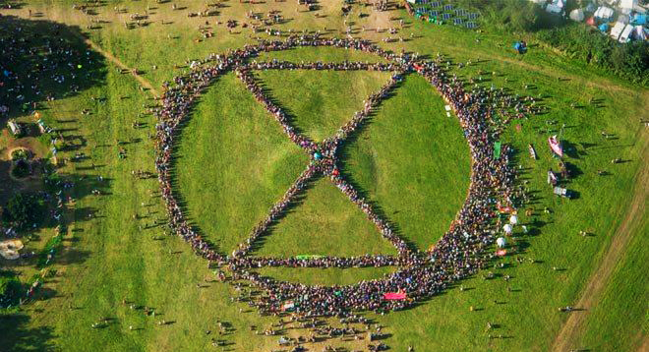
COMMUNITY RESILIENCE & PARTICIPATION

Slide 40
DEEP CANVASSING
The Sanders campaign taught us the effectiveness of the Deep Canvassing model which is essentially that conversations with people in the public should be mainly aimed at:
Giving them plenty of time to speak (not a 2min pitch of getting your ‘message across’)
Being vulnerable in interactions and sharing stories to build close connection (More ‘normal conversation’ than salesman technique’)
Gauging opinions change/enthusiasm on a scale of 1-10
Inviting people along to weekly meeting/upcoming events
This should be prototyped with organisers in progressive communities. Changes can then be made based on reaction and then shared with wider group to practice across the city.

Slide 41
REBEL RINGING
What is a Phone Bank?
A Phone Bank is… a group of friends, activists or volunteers making phone calls to reach out to other activists or members of the public – to inform and engage them in a movement.
On my own I could reach 10 people in an hour. With four friends we could reach 50. Especially recommended are Rebel Ringer Phone Bank Parties where a Host provides a friendly space for a couple of hours of calling.… a great way to get to know or catch-up with your affinity group / other local Rebels.
What is rebel ringing?
Rebel Ringers are the Phone Bank wing of XR! It's all about that personal touch – real human interaction is impactful and empowering. XR volunteers have already made thousands of calls and shared many wonderful connections. Rebel Ringing is a flexible way to help - all you need is a phone with free calling minutes, a laptop/tablet, and a free hour or two. Once you are up and running you can encourage others to get involved by forming a Phone Bank.

Slide 42
NEW GROUPS - CONNECTING COMMUNITIES
A great way to help to grow into new community is to set up groups for those communities within XR like XR Students, Youth, Jews, Muslims, Families or Elders.
Spaces for these groups to organise will bring new people that are interested in getting involved with people like them. They will also focus more on outreaching into their own community which makes their messaging more powerful and relevant to certain people.
You can set up a Facebook group for the group to get started and find some key organisers!

Slide 43
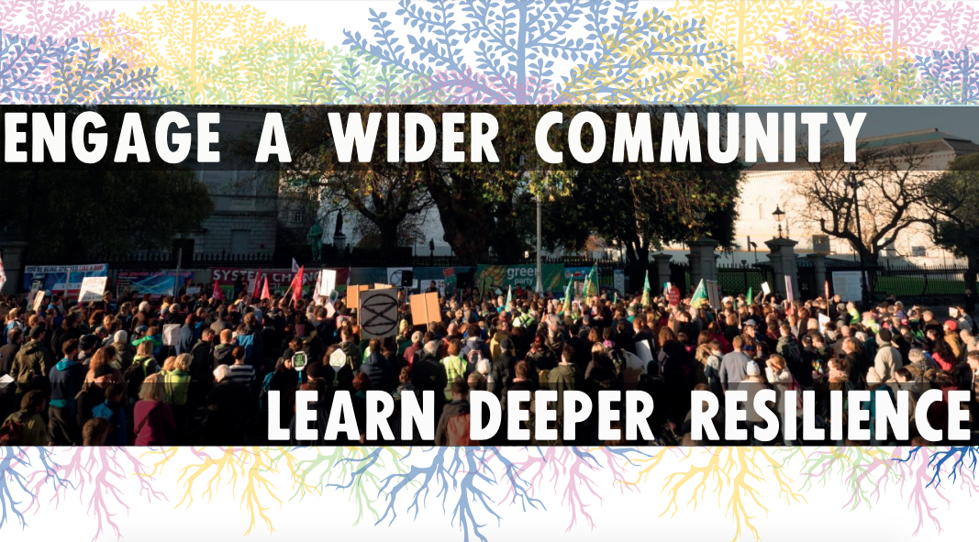

Slide 44
BUILDING COMMUNITY RESILIENCE
Throughout the process of starting a local group, the group may not work out as you pictured it or as is detailed above. Different groups will also work better with different structures that are more suited to them and that’s fine. This document is just a guideline to help groups along the way.
The majority of us are only just starting to de-school our mind from centralised and hierarchical ways of thinking about how groups and organisations work. There will be bumps along the way and sometimes it will feel pretty chaotic (in fact maybe most of the time!) but through this decentralising we are reconnecting more communities.
Extinction Rebellion often recommends looking at this through a service orientation - this means that instead of expecting x outcome when you do y, you do y because you believe it is the right thing to do.
For example, if you organise a public meeting, publicise it online, share around flyers etc and only have two people show up, it's okay with it because you did the right thing by organising the meeting itself. Letting go of the expected outcomes of our actions helps to better connect with the intent behind them and be more resilient when things go unexpectedly.

Slide 45

LISTENING CIRCLES
Emotions drive us! We are trying to trigger an emotional reaction in the public around the emergency. Part of that also means connecting with our emotions around the current collapse.
In this emergency, it is so important that we express how we feel about what is happening. Opening listening circles gives teams and small groups a chance to really hear where everyone is at, which can be difficult but deeply bonding. We need these connections to be happening all across the country to connect rebels to their deeper purpose.
Together, we are rooted in love and compassion.

Slide 46
CONFLICT & HOW WE RESPOND TO IT
Conflict will arise in all groups, no matter how well intentioned everyone there is. It is a natural part about being a community. That means that the community should take responsibility for dealing with the conflict.
Group Agreements and our Ways of Working make a huge difference in with conflict as you can refer those are breaking them back to community agreements rather than personal disagreements. If people are continually breaking them and dragging energy out of the group, it is important to then ask those people to leave.

Slide 47

PEOPLE'S ASSEMBLIES
People’s Assemblies are a great way of engaging people in your group and your local area on key issue. They create the kind of participatory democracy platforms that we want to see in the world, ones that empower ordinary people to make decisions.
In your local group, you might want to run assemblies on topics like “How do we prepare for the rebellion? or "How do we reach more people in our community? ”
In your local area, you might want to set up an open, public event where people can gather to talk about broader topics like “What can we do about the climate crisis?” These conversations, and appropriate follow up action on them, empower people to be a part of the movement.

Slide 48
REBEL MEETINGS
Once your meetings have grown to the point when you have new people joining your working groups every week, but often don’t come back, it might be time to separate your General meeting into a Working Group meeting and a Rebel meeting.
Working Group meetings are smaller and focused on organising their specific groups (e.g Regenerative Culture) and having a Coordination Group meeting. They are often not advertised on public on social media.
Rebel Meetings are focused on providing a community space where people can eat, learn more about the rebellion and find simple ways of getting involved.
A Standard Outline for the first five weeks might be:
Week 1: Heading for Extinction Talk
Week 2: Welcoming Meeting
Week 3/4: NVDA training and Action Group Formation
Week 5: Community Organising Training
Week 6: Peoples Assembly

Slide 49
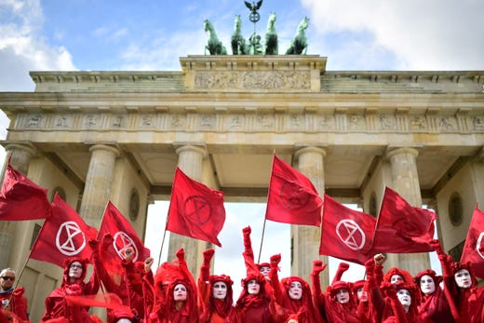
GROWING YOUR GROUP II

Slide 50

GROWING PAINS
OK so we just had a rebellion and your group is twice the size it was before, people are cramming into the room you hired and working groups are going to be too big to get anything done. What do you do?
When your group is growing, it is good to start to think about how everyone is going to get involved. If there are 100+ people in meetings, consider splitting into other parts of the city.

Slide 51
SPLITTING THE GROUP
Spreading to new parts of your town/city will help to engage people who are more local to that area and will take the pressure of numbers off your original General Meeting. To split:
Find people from that area who are happy to host Rebel Meetings
Run a talk in the area to get people interested
Plan a series of talks and trainings for the first five/six meetings
Run the first welcoming meeting with food and see who’s up for helping to host the meetings
(e.g welcoming people at the door, making food, run trainings etc)

Slide 52
REBEL MEETINGS 2.0
Once your rebels meetings are up and running, you might want to think about how you can provide a pathway to action for the people that turn up. 80% of the new people that come along to meetings don’t want to be involved in ongoing organising, like being in a working group.
They want to be a part of the movement in an easier way. So you can run stalls at the end of each your Rebel Meetings, each of which advertises an exciting way of getting involved after the meeting has ended.
For example, you might have 4 stalls, each with a couple of volunteers behind them that can then take signs up for each role at the end of the meeting.
Rebel Ringing
Door Knocking /
Flyering
Printing
Flyposting /
Paint the Streets

Slide 53
STRUCTURING YOUR GROUP
Now your group is growing but people aren’t sure who is doing what, who to get in contact with or who is making major decisions.
There are nearly 500 local, regional and national groups across the world, each of which is building its own structures with different working groups.
One method of structuring is to implement the Self Organising System! (SOS)
The SOS will help you to keep track of who is doing and what and being transparent it, have good meetings and help your working groups to grow with subgroups.
The structure aims to empower anybody to act as part of XR, so long as they agree to follow the ten core principles. You can check out this Self-Organising System document for more information. We are seeking a balance between being able to act quickly in response to fast-changing situations and being able to integrate the collective wisdom of multiple perspectives when needed.

Slide 54
MOBILISING THE LOCAL NEIGHBOURHOOD
A powerful to way to encourage people to get more involved is to localise the actions as much as possible. If someone says, “do you wanna go flyering in city centre or around the corner from your road”, which would you pick? Which would you more likely turn up for? Here are some tips on flyering in your area.
Getting your local groups in local postcode areas through Signal or Whatsapp links can be a powerful way of encouraging decentralised action and socialising. It can help activate people who don’t want to go meetings in city centre but do want to chat locally.

Slide 55
PRESSURING LOCAL COUNCIL
Don’t forget what we’re aiming for!
Putting pressure on local councils to meet our demands can help to transform your local community and help put pressure on central Government:
Demand them to set up a Local Citizens Assembly on Climate and Ecological Breakdown
Encourage them to Rebel against central Government by not paying their taxes, workers strikes and councillors resigning in protest
Have a people’s assembly to decide on simple, local demands like “Stop the Airport expansion.

Slide 56
COMMUNITY VOLUNTEERING
Community service can help the group move from not just protest style events but also something that is giving back to the local community.
This would help build relationships in the group and spread the word of peaceful rebellion into the city.
This can initially work with existing organisations and eventually become alternative systems, should we want to not cooperate with the Government. Example areas to focus on and help build relationships in:
Food Sustainability
(We want resilient communities)
Food Waste Cafes
Growing and gardening projects
Homelessness
(We look after each other)
Shelters
Migrants
(We show compassion and want Climate Justice)
Refugee Rights and Education
Transport
(We want to move away from fossil fuels)
Bike Workshops

Slide 57
ORGANISING A GATHERING
Once your group has got a working group structure and people regularly coming to meetings, you might want to start connecting with other groups around you.
A great way to do this is to organise a local, regional or national gathering - depending on your size!
The gathering might be do help train rebels up in different skills - e.g. facilitation, NVDA, or social media. Perhaps it will be an opportunity to connect and get to know rebels in a regenerative setting - or maybe both!
Here are some useful tips for getting started!

Slide 58
'If I can't dance to it, it's not my revolution'
- Emma Goldman
This document is only a guide. We are an international movement, and each country will have its own needs and context. We welcome you to adapt all the information here to your local situation!

Slide 59
OUR PRINCIPLES & VALUES
Any person or group can organise autonomously and take action in the name and spirit of XR so long as the action fits within XR’s principles and values. In this way, power is decentralised, meaning that there is no need to ask for permission from a central group or authority.
1. We have a shared vision of change creating a world that is fit for the next 7 generations to live in.
2. We set our mission on what is necessary mobilising 3.5% of the population to achieve system change – such as “momentum-driven organising” to achieve this.
3. We need a regenerative culture creating a culture which is healthy, resilient and adaptable.
4. We openly challenge ourselves and this toxic system leaving our comfort zones to take action for change.
5. We value reflecting and learning following a cycle of action, reflection, learning, and planning for more action. Learning from other movements and contexts as well as our own experiences.
6.We welcome everyone and every part of everyone working actively to create safer and more accessible spaces.
7. We actively mitigate for power breaking down hierarchies of power for more equitable participation.
8. We avoid blaming and shaming we live in a toxic system, but no one individual is to blame.
9. We are a nonviolent network using nonviolent strategy and tactics as the most effective way to bring about change.
10.We are based on autonomy and decentralisation we collectively create the structures we need to challenge power. Anyone who follows these core principles and values can take action in our name.

Slide 60
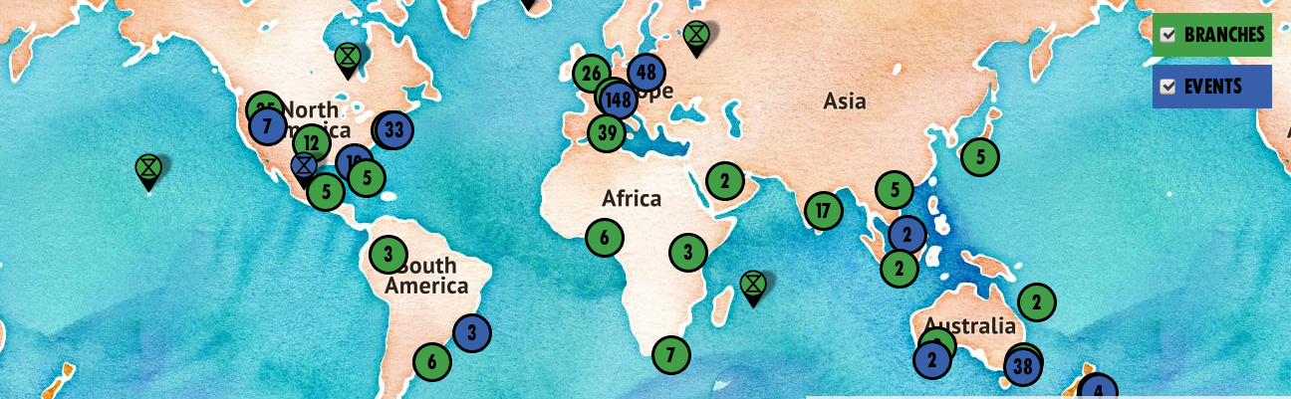
As a community, we continue to grow, adapt and organise to rebel for life. Together, we are creating something beautiful.
If you have any questions about anything XR related, or you are just looking for support, don’t hesitate to contact:
International Support Team
contact@rebellion.global
Regional Liaison Coordinators
XR-RegionalLiaisons@protonmail.com
Or your national/regional coordinators

Slide 61
DO YOU COMMIT TO NONVIOLENCE?
ARE YOU ALIGNED WITH OUR PRINCIPLES AND AIMS?
IF SO YOU ARE EXTINCTION REBELLION AND YOU CAN ACT
IN OUR NAME.
More questions? Know the facts

